Slide 1


Review of Data Analysis Services (WP4)
28 April, 2021
Authors: Andy Götz (coordinator)+ Fabio Dall’Antonio (WP4 leader)
Place: PaNOSC Project Management Committee zoom meeting
This project has received funding from the European Union’s Horizon 2020 research and innovation programme under grant agreement No. 823852

Slide 2
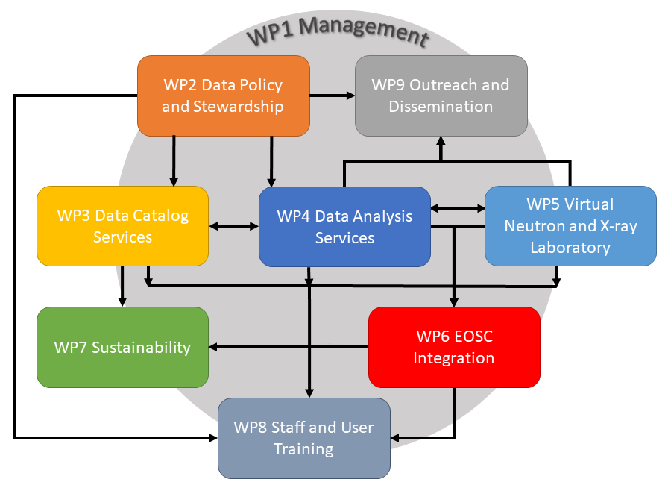
WP4
Data Analysis Services – at the core of PaNOSC
This project has received funding from the European Union’s Horizon 2020 research and innovation programme under grant agreement No. 823852

Slide 3
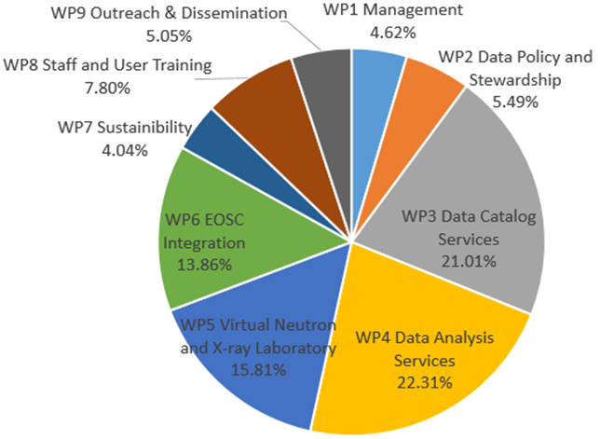
WP4
Data Analysis Services – largest WP of PaNOSC
This project has received funding from the European Union’s Horizon 2020 research and innovation programme under grant agreement No. 823852

Slide 4
WP4
Data Analysis Services – Effort per partner
1 - ILL 71.00
2 - European XFEL 60.00 (WP leader)
3 - CERIC-ERIC 60.00
4 - ELI-DC 50.00
5 - ESRF 36.00
6 - ESS 32.00
Total 309.00 (~ 25 years)
This project has received funding from the European Union’s Horizon 2020 research and innovation programme under grant agreement No. 823852

Slide 5
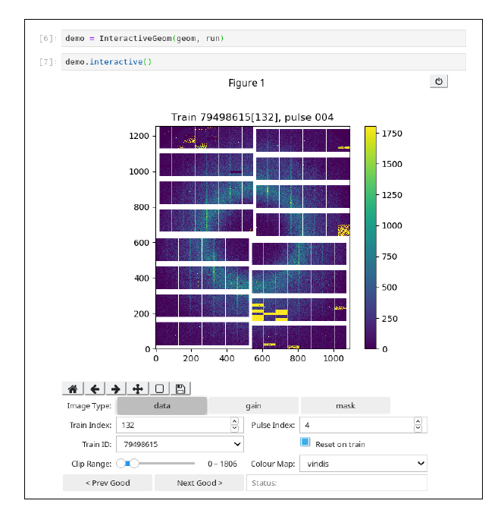
WP4
Data Analysis Services - choices
Jupyter Notebooks
VISA Remote Desktop in Browser
Remote data analysis portal (ILL+ESRF)
HDF5 and visualisation in notebooks (EuXFEL, ILL, ESRF, ESS)
This project has received funding from the European Union’s Horizon 2020 research and innovation programme under grant agreement No. 823852

Slide 6
WP4
Data Analysis Services progress
Recruitment of staff
Identify key science users and scientific use
Research literature on computational workflows
Move analysis capabilities into Jupyter notebook
Moving analysis tools into containers to run analysis out of containers (EuXFEL, ESRF)
Started to design remote analysis architecture (ILL+ESRF)
HDF5 and visualisation in notebooks (EuXFEL, ILL, ESRF, ESS)
Questionnaire on data analysis for participating facilities as been sent out (Task 4.1)
Engage with other Work Packages and initiatives
https://github.com/panosc-eu/panosc/tree/master/Work%20Packages/WP4%20Data%20analysis%20services/use_cases

Slide 7
WP4
Data Analysis Services status in 4/2021
Recruitment of staff
Identify key science users and scientific use (ALL)
Research literature on computational workflows (ESRF)
Move analysis capabilities into Jupyter notebook (EuXFEL, ESRF, ELI, ESS, )
Moving analysis tools into containers to run analysis out of containers (EuXFEL, ESRF)
Started to design remote analysis architecture (ILL+ESRF)
HDF5 and visualisation in notebooks (EuXFEL, ILL, ESRF, ESS)
Questionnaire on data analysis (Task 4.1)
Engage with other Work Packages and initiatives
Remote access for remote experiments due to COVID-19 (ILL, CERIC, ESRF)
Scientific Use Cases: https://www.panosc.eu/use-cases/

Slide 8
WP4
Data Analysis Services issues in 4/2021
Implementation of PaN portal backend (ILL+CERIC)
Implementation of PaN portal frontend (ELI)
Development of Jupyter extensions + tools (ESRF+EuXFEL)
Deployment of PaN portal in production at partner sites (ALL)
https://github.com/panosc-eu/panosc/tree/master/Work%20Packages/WP4%20Data%20analysis%20services/use_cases

Slide 9
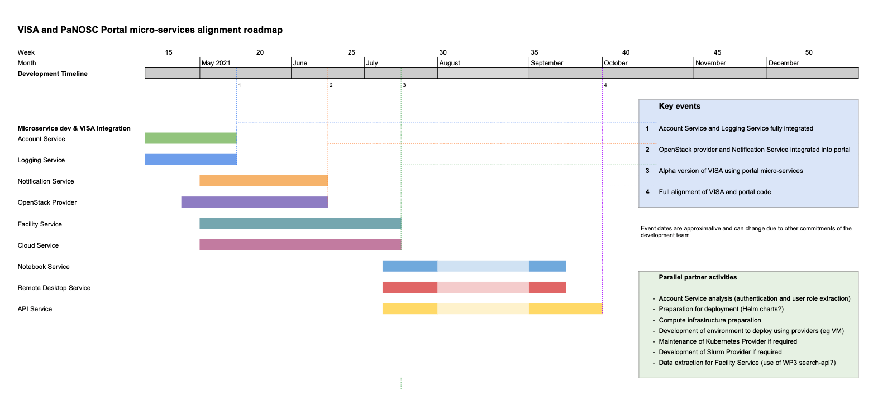
PaN portal Roadmap in 4/2021 (thanks ILL!)

Slide 10
PaNOSC KPIs
 | ILL | ESRF | CERIC | XFEL | ELI | ESS
Open Data 2018 | 100s | 2 | 0 | 10s | 0 | 0
Open Data 2023 | 1000s | 1000s | 100s | 1000s | 100s | 10s
Data Services 2018 | Pilot | In progress | Remote | In progress | ? | In progress
Data Services 2023 | Desktop Jupyter | Jupyter Desktop | Jupyter Desktop | Jupyter Desktop | Desktop Jupyter | Jupyter Desktop
Common data API 2018 | No | No | No | No | No | No
Common data API 2023 | Yes | Yes | Yes | Yes | Yes | Yes
User training 2018 | No | No | No | No | No | No
User training 2023 | Yes | Yes | Yes | Yes | Yes | Yes
This project has received funding from the European Union’s Horizon 2020 research and innovation programme under grant agreement No. 823852

Slide 11
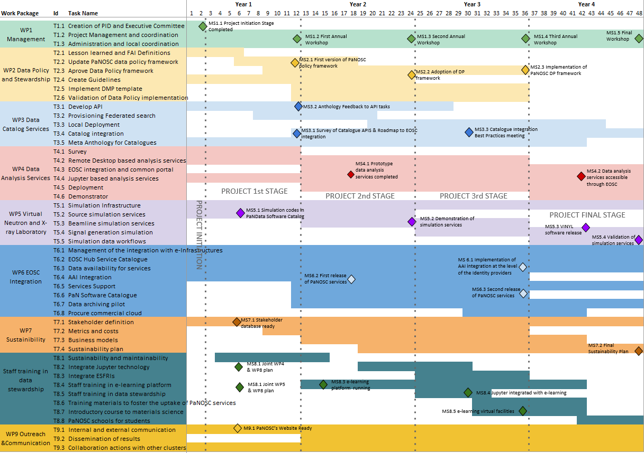
Apr 2021
PaNOSC Milestones

Slide 12
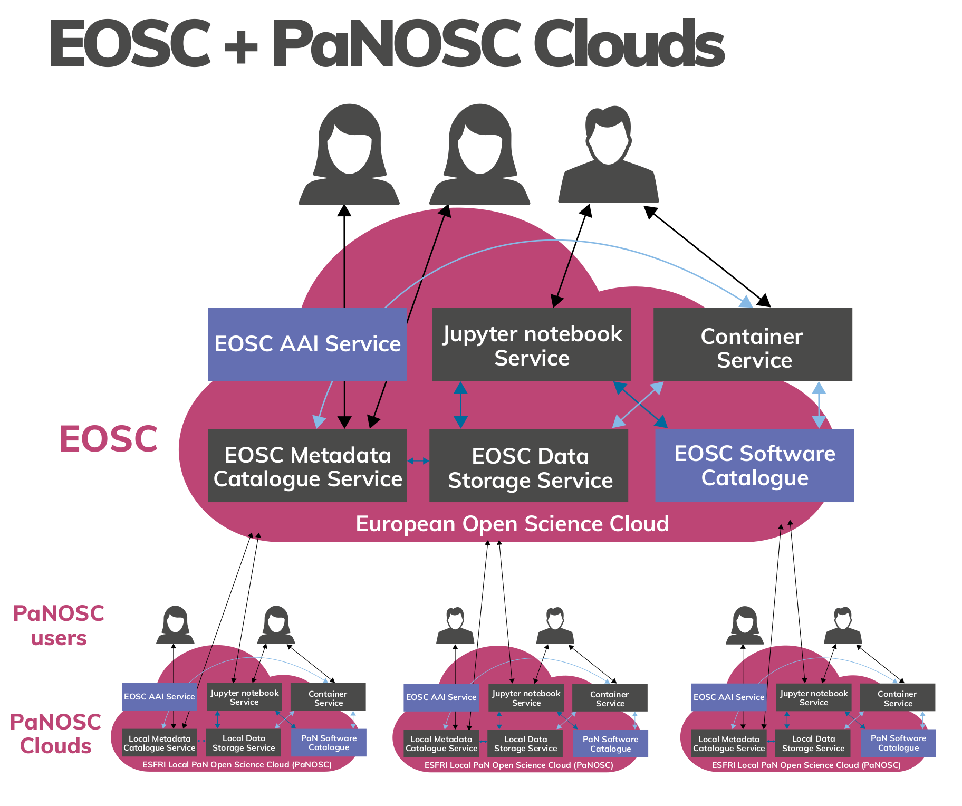

Our Vision – a PaN scientific commons
This project has received funding from the European Union’s Horizon 2020 research and innovation programme under grant agreement No. 823852

Slide 13

How to go from this …

Slide 14


to this … SUCCESS !
SUCCESS = 1. ALL partners have the portal in production
2. ALL partners contribute to the code

Slide 15
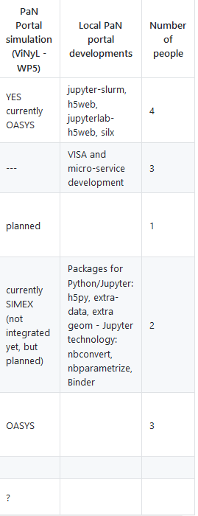
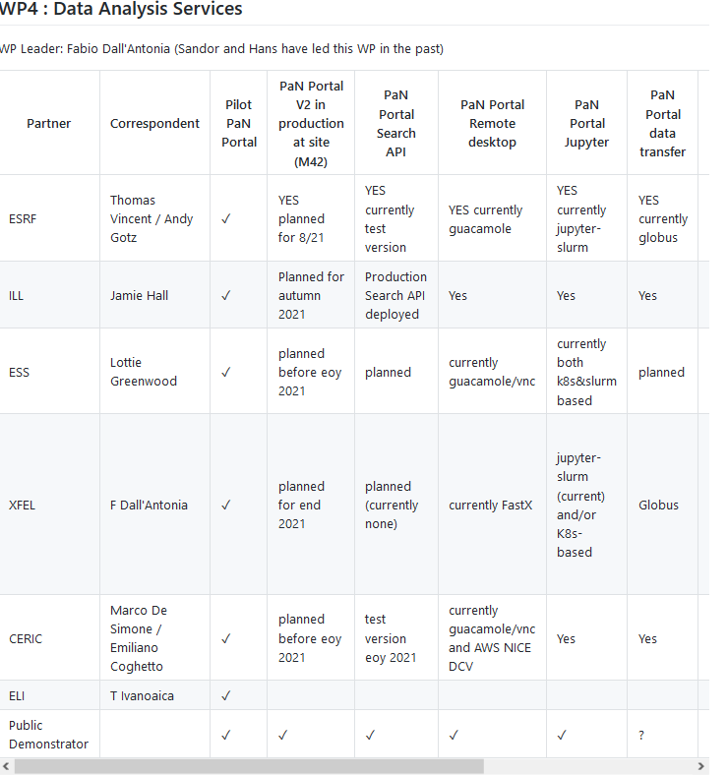
Data Analysis Services – dashboard

Slide 16
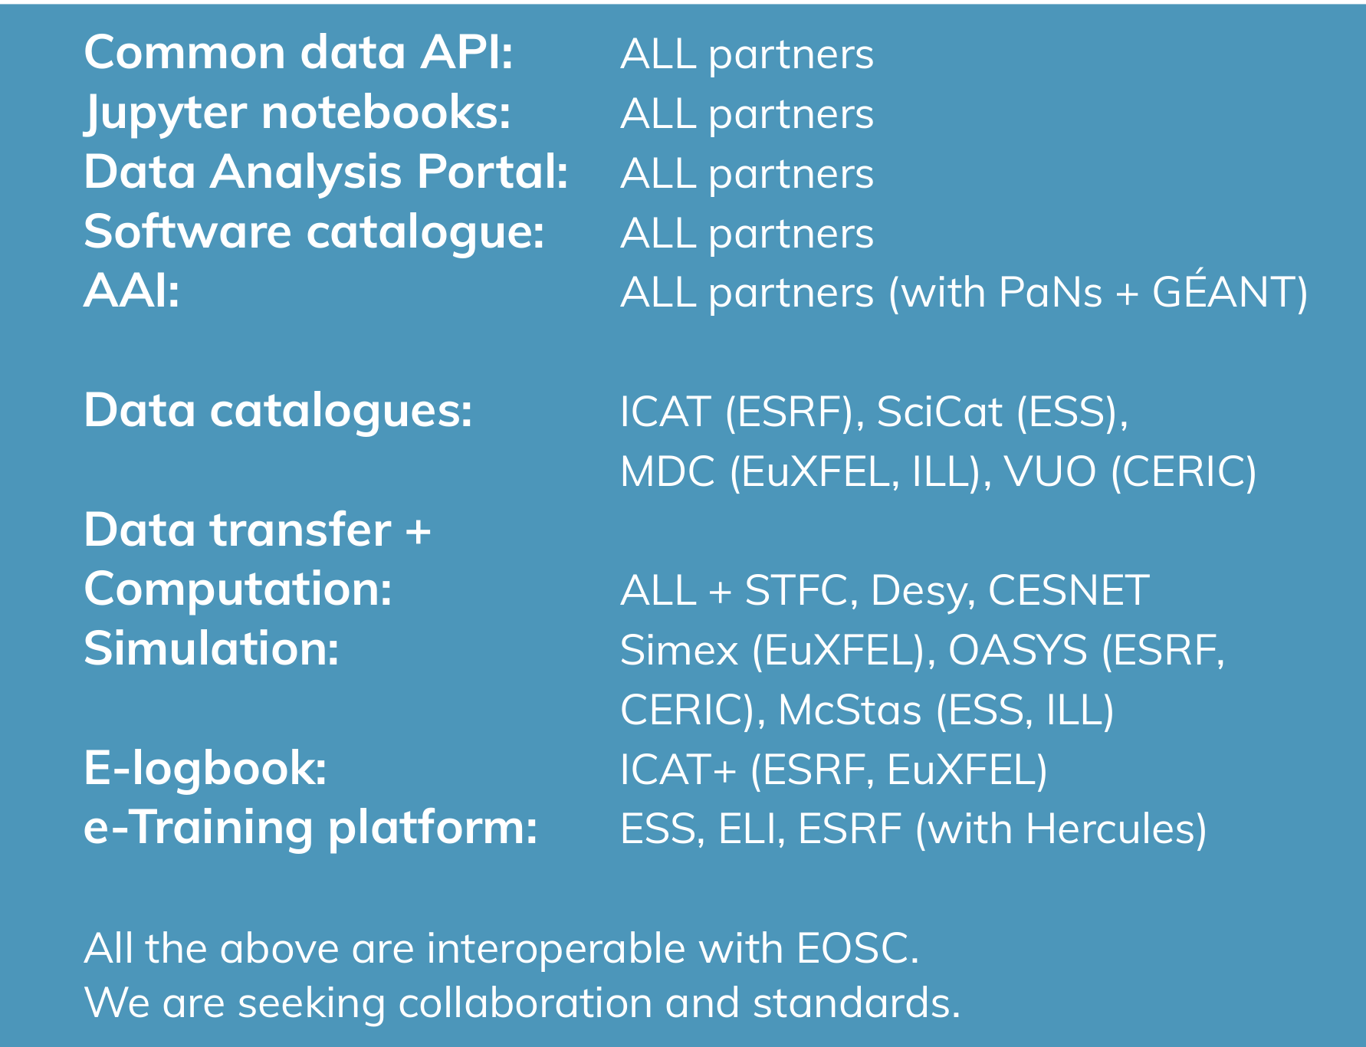
PaNOSC’s Developments
This project has received funding from the European Union’s Horizon 2020 research and innovation programme under grant agreement No. 823852

